Slide 1
Topic: Fractions, decimals, & percentages
EQ: How do I convert between fractions, decimals and percentages?
Rule up for 3-column notes! ☺

Slide 2
24
7
30
Three Column Example
Date
EQ –
Question
Examples
Steps

Slide 3
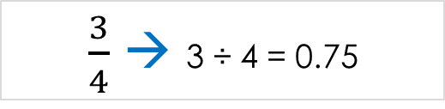
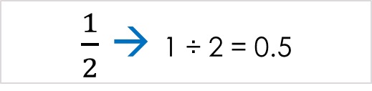
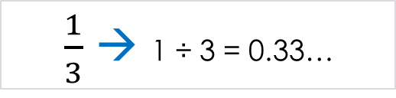
Topic: Fractions, decimals, & percentages
EQ: How do I convert between fractions, decimals and percentages?
Question:
Explanation:
Example:
How do I convert a fraction into a decimal?
Divide the numerator (the top number) by the denominator (the bottom number)
$\frac{1}{2}$ → 1 ÷ 2 = 0.5
$\frac{3}{4}$ → 3 ÷ 4 = 0.75
$\frac{1}{3}$ → 1 ÷ 3 = 0.33…

Slide 4
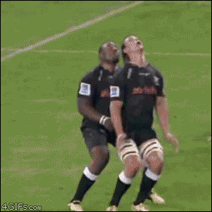

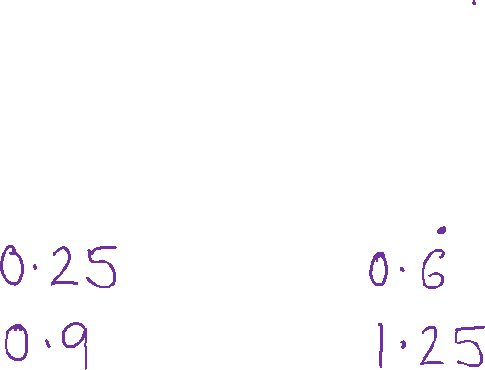

Think-Pair-Share
In Pairs try converting these 4 fractions into decimals
Be ready to share your answers with the class!
$\frac{1}{4}$
$\frac{7}{8}$
#teamwork
$\frac{2}{3}$
$\frac{5}{4}$
Notes:
¼ = 0.25 = 25%
7/8 = 0.875 = 87.5%
2/3 = 0.667 = 66.7%
5/4 = 1.25 = 125%

Slide 5
Topic: Fractions, decimals, & percentages
EQ: How do I convert between fractions, decimals and percentages?
Question:
Explanation:
Example:
Now I have a decimal how do I convert it into a percentage?
To convert a decimal into a percentage it needs to be multiplied by 100.
0.5 → 0.5 x 100 = 50%
0.75 → 0.75 x 100 = 75%
0.33… → 0.33… x 100 = 33.33%

Slide 6
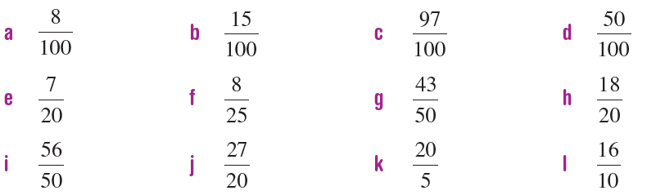
Left-Hand-Side Task 1
Check your answers
8%
15%
97%
50%
35%
32%
86%
90%
112%
135%
400%
160%
Convert these fractions into percentages by first converting them into decimals:

Slide 7
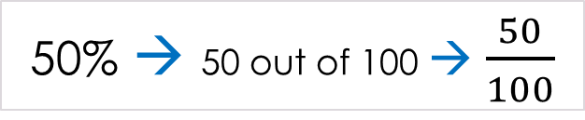
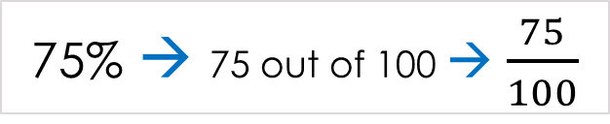
Topic: Fractions, decimals, & percentages
EQ: How do I convert between fractions, decimals and percentages?
Question:
Explanation:
Example:
The symbol, %, means ‘per cent’, which means “out of 100”.
Therefore, 75% means 75 out of 100.
We can write percentages as fractions by changing the % sign to a denominator of 100 (meaning out of 100)
What is a percentage?
50% → 50 out of 100 → $\frac{50}{100}$
75% → 75 out of 100 → $\frac{75}{100}$
Can we simplify these fractions?
Notes:
We can simplify them to ½ and ¾

Slide 8
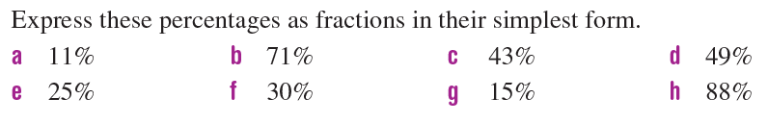
Left-Hand-Side Task 2
Check your answers!
a. 11/100 b. 71/100 c. 43/100 d. 49/100 e. 1/4 f. 3/10 g. 3/20 h. 22/25

Slide 9
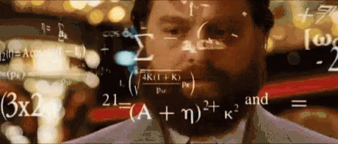
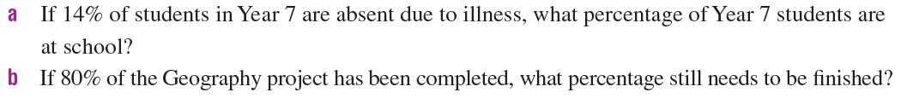
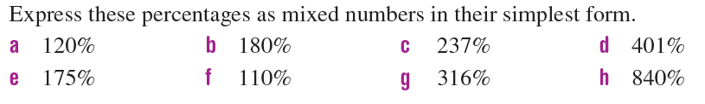
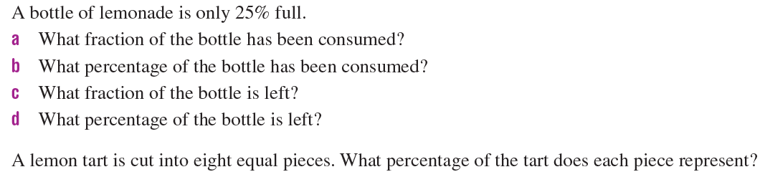
Left-Hand-Side Task 3
Notes:
1a. 86% 1b. 20% 2a. 120/100=12/10=6/5=1 1/5 2b. 180/100=18/10=9/5=1 4/5 2c. 237/100=2 37/100 2d. 401/100=4 1/100 2e. 175/100=35/20=7/4=1 ¾
2f. 110/100=11/10=1 1/10 2g. 316/100=79/25=3 4/25 2h. 840/100=84/10=8 4/10=8 2/5
3a. ¾ 3b. 75% 3c. ¼ 3d. 25%
4. 12.5%

